Slide 1
Grief and Loss
First Nations Experiences
Tracey Cairns
tcpsych@outlook.com

Slide 2
Welcome
I acknowledge the Dharawal/Tharawal Nation as the traditional owners of this land and thank them for their continuing custodianship of the land, sea and community.
I pay my respect to Dharawal/Tharawal culture and to the Elders (past, present and emerging)

Slide 3
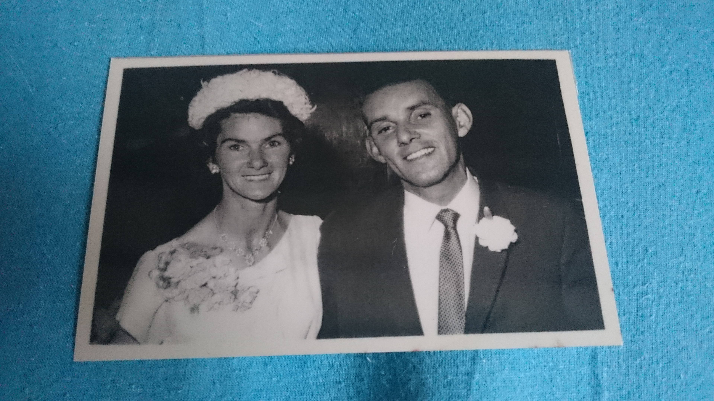
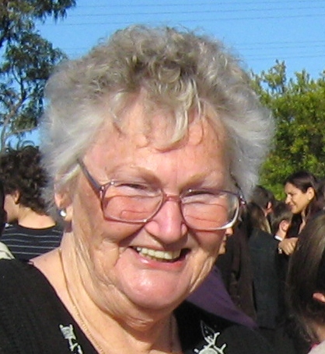
My story
My grandmother was a Wiradjuri woman (Blayney)
Removed from her family and adopted by a non-Aboriginal family at about eighteen months old
My father and his sister grew up without their mother
I grew up, and live, in the Illawarra (Warilla)
I was told my grandmother had died, and grew up
with no connection to my Wiradjuri culture

Slide 4
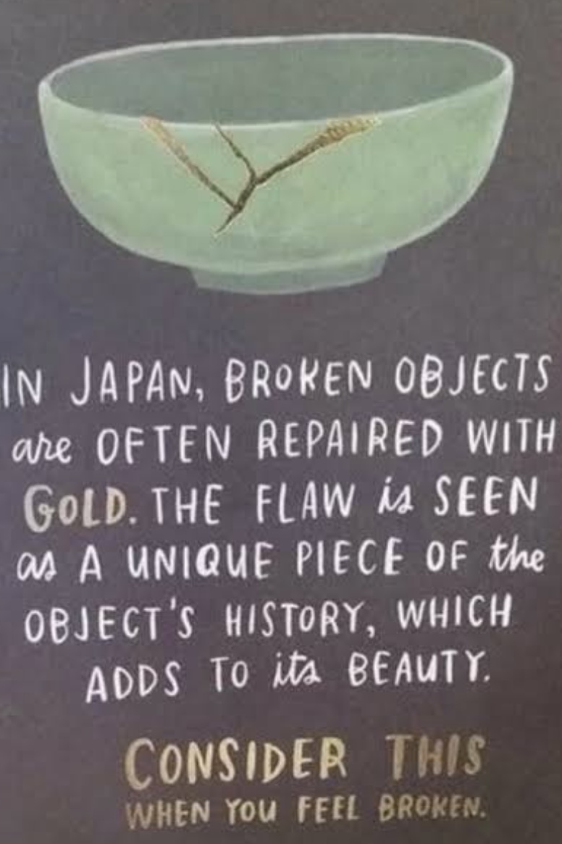
Wellness advice
The presentation may trigger distress
as it explores intense and distressing
feelings
Please consider your wellness needs
and feel free to take time away from
the presentation if you feel triggered
by the issues raised
(these will include colonisation and
the social issues that impact on First
Nations People)

Slide 5
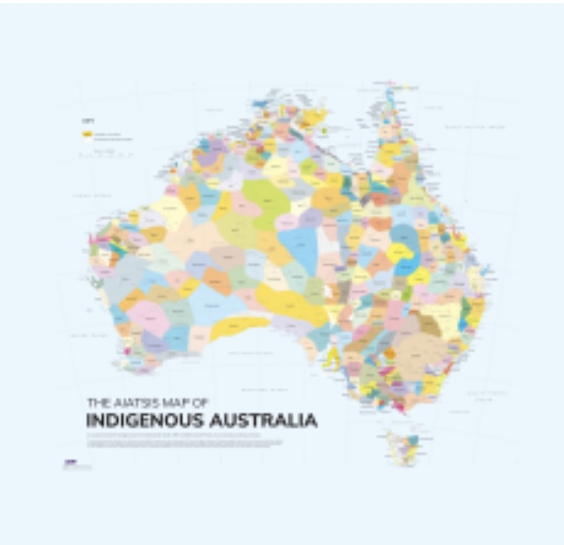
Points to remember
There are many First Nations – not one group
Beliefs and practices associated with grief need to be checked with each individual and family
Colonisation has interrupted many people’s connection to their culture – so there may be a mix of traditional and non-traditional beliefs and practices associated with grief
Some traditional beliefs and practices will be private to the community or Nation, and so may not be shared with others
First Nations cultures are based on oral learning and so conversation and stories are the best way of sharing knowledge
I am speaking from my experience and clinical knowledge (not on behalf of any community)

Slide 6
The Healing Foundation –
Intergenerational Trauma Animation
For use by Workers – not to be shared with children

Slide 7
Gaps that contribute to grief and loss
Family and community members dying earlier than would be expected in non-Aboriginal families and often in tragic circumstances
Adverse childhood experiences – four or more increases vulnerability to poor mental and physical health outcomes
Colonisation (intergenerational trauma and current issues)
Not having basic needs met
Confused sense of belonging

Slide 8
Societal influences
Bushfires and floods (direct impact and harm to land)
Covid (disconnection from School and friends – fear for Elders/fear of more loss)
Referendum on the Voice (widespread comments on culture, community disagreement, personal bullying)

Slide 9
‘Sorry time is like a sadness that is forever.
(It’s) important to spread sadness so you wear it out’
(Aunty Margaret – Northern Territory)
‘Grief is a consequence of love’
(Port Lincoln Support Group)
‘When I think about what grief means,
I think it means honour, integrity –
A place to fall over and sit down’
(Port Lincoln Support Group)

Slide 10
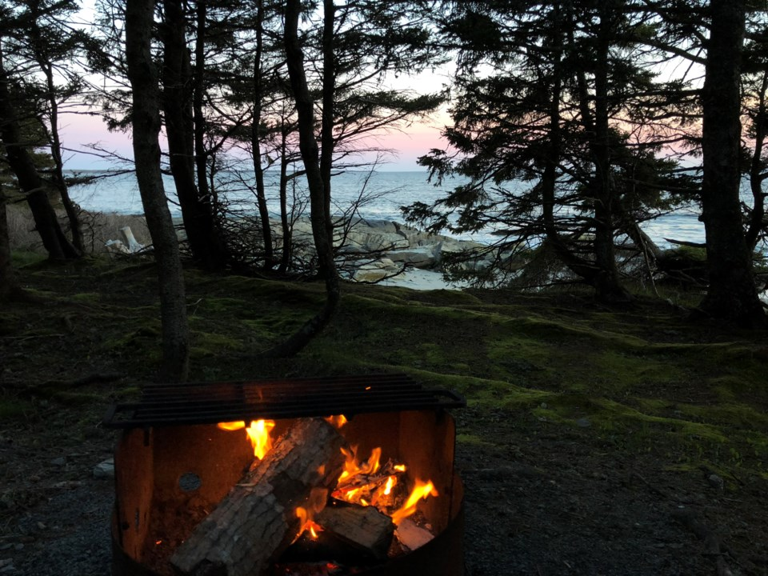
Rituals to spread (share) sorry business
Dancing
Stories
Art
Women’s business
Men’s business

Slide 11
Helpful strategies
Allow time for Sorry Business (which may mean travel or extended time with family)
3
4
Aassist with practical matters (dealing with Government agencies or processes, money to travel)
2
Avoid assumptions – each Nation will have their own Lore
1
Respect privacy – talk to the family and follow their wishes

Slide 12
Dadirri
Inner deep listening and quiet still awareness
From the Ngan’gikurunggurr and Ngen’giwumirri languages of the Aboriginal peoples of the Daly River region (Northern Territory, Australia)
A technique to tap into the deep spring of wellness that is within us
‘My people are not threatened by silence’
Aunty Miriam Rose Ungunmerr
Notes:
https://www.google.com.au/url?sa=t&rct=j&q=&esrc=s&source=web&cd=&cad=rja&uact=8&ved=2ahUKEwiMk4qpx92AAxVvSmwGHf5zBXUQz40FegQIChAK&url=https%3A%2F%2Fwww.youtube.com%2Fwatch%3Fv%3Dtow2tR_ezL8&usg=AOvVaw2evjtkCjwOH7em61er2K3A&opi=89978449

Slide 14
Thank you

