Slide 1


Belonging and Togetherness
How children and young people
imagine an inclusive future free from
racism and discrimination
South Coast Child Wellbeing Network Conference
15 September 2026

Slide 2

Acknowledgement of Country
We acknowledge the Traditional Custodians of the various lands on which we work, pay our respects to Elders past and present and emerging young leaders.

Slide 3
Our young people are not the gap. Our young people are strong, talented, cultural, creative, and our young people are ready to lead. The gap is the system not meeting them early enough, locally enough, or culturally enough."
– Young Aboriginal person, Thirriwirri consultation
“

Slide 4
Introduction
1
What we know about children and young people’s experiences in 2026

Slide 5
Top-of-Mind Issues for Young People
Mental Health and
Wellbeing
Cost of Living
(13–24-year-olds)
Social Media Delay
(10–15-year-olds)
Education
Youth Week Polling (2026). NSW Office for Youth.

Slide 6
Some groups of young people are struggling more than others
Cohorts with difficulties accessing and affording various government services include:
LGBTQIA+;
Culturally and linguistically diverse;
Aboriginal and Torres Strait Islander,
Girls and young women, and
Disability or diverse health experiences.
1 in 3
Young people report experiencing bullying or discrimination.
Experiences are higher for those identifying as:
LGBTQIA+;
Aboriginal and Torres Strait Islanders; and
those with disability.
. ​
Youth Week Polling (2026). NSW Office for Youth.
6

Slide 7
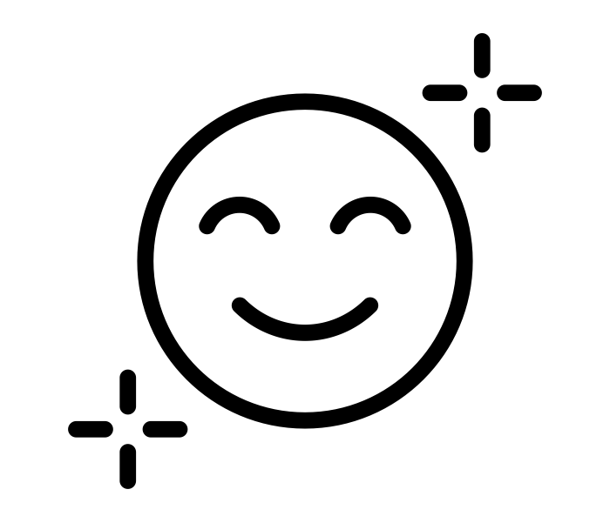
Key Insights – Life in NSW
83% say they feel happy or very happy about their life in the last 12 months.
Young people with mental health conditions, disability, diverse health experiences, living in regional areas, identifying as LGBTQIA+ or at TAFE/VET were more likely to feel unhappy about life.
Youth Week Polling (2026). NSW Office for Youth.

Slide 8
Life sentiment
Most young people are either happy (50%) or very happy (33%) in how they feel about their life over the past 12 months.
2026
2025
2024
2023
2022
Overall life satisfaction
NET Happy + Very happy (%)
83%
88%
87%
87%
88%
1%
1%
1%
Youth Week Polling (2026). NSW Office for Youth.

Slide 9

Key Insights – Life in NSW
83% say they feel happy or very happy about their life in the last 12 months.
Young people with mental health conditions, disability, diverse health experiences, living in regional areas, identifying as LGBTQIA+ or at TAFE/VET were more likely to feel unhappy about life.
Sense of belonging is strongest in the home and with family (58%) and with friends (43%).
1 in 3 young people also feel a lot of belonging when with their cultural or religious community or with online only friends.
Youth Week Polling (2026). NSW Office for Youth.

Slide 10

Key Insights – Life in NSW
83% say they feel happy or very happy about their life in the last 12 months.
Many young people can access and afford key services. But this is not equal.
Young people with mental health conditions, disability, diverse health experiences, living in regional areas, identifying as LGBTQIA+ or at TAFE/VET were more likely to feel unhappy about life.
Access and affordability are rated lower by young people who are Aboriginal and Torres Strait Islander, LGBTQIA+, CaLD, or live with mental health, disability and diverse health experiences.
Sense of belonging is strongest in the home and with family (58%) and with friends (43%).
1 in 3 young people also feel a lot of belonging when with their cultural or religious community or with online only friends.
Youth Week Polling (2026). NSW Office for Youth.

Slide 11
Accessibility of services
Most young people agree that all services tested are accessible when they need them.
 |  | NET Agree + Strongly agree (%)
 |  | Total | Aboriginal and Torres Strait Islander | CaLD | MH Condition | LGBTQIA + | Metro | Regional
Sports, clubs and activities |  | 83% | 70% | 78% | 64% | 68% | 82% | 84%
Youth spaces (places for children, teens, and young people) |  | 74% | 66% | 55% | 37% | 33% | 72% | 78%
Public transport (e.g. buses, trains, light rail) |  | 85% | 67% | 83% | 88% | 76% | 86% | 84%
Mental health services (e.g. counsellors, psychologists, or helplines) |  | 76% | 69% | 59% | 46% | 47% | 75% | 78%
Accessibility of services
1%
2%
1%
1%
2%
1%
Youth Week Polling (2026). NSW Office for Youth.
Significantly higher/lower

Slide 12
Accessibility of services
 |  | NET Agree + Strongly agree (%)
 |  | Total | Illawarra
Sports, clubs and activities |  | 83% | 90%
Youth spaces (places for children, teens, and young people) |  | 74% | 63%
Public transport (e.g. buses, trains, light rail) |  | 85% | 84%
Mental health services (e.g. counsellors, psychologists, or helplines) |  | 76% | 48%
Accessibility of services
1%
2%
1%
1%
2%
1%
Youth Week Polling (2026). NSW Office for Youth.
Significantly higher/lower

Slide 13
Affordability of services
Around three in five young people agree that all services tested are affordable.
 |  | NET Agree + Strongly agree (%)
 |  | Total | Girls | CaLD | LBTQIA+ | MH condition | Metro | Regional
Sports, clubs and activities |  | 69% | 63% | 44% | 34% | 30% | 68% | 73%
Youth spaces (places for children, teens, and young people) |  | 70% | 68% | 45% | 38% | 38% | 69% | 74%
Public transport (e.g. buses, trains, light rail) |  | 78% | 75% | 62% | 56% | 59% | 76% | 83%
Mental health services (e.g. counsellors, psychologists, or helplines) |  | 65% | 60% | 34% | 25% | 12% | 63% | 68%
Affordability of services
3%
1%
2%
2%
2%
2%
Youth Week Polling (2026). NSW Office for Youth.
Significantly higher/lower

Slide 14
Affordability of services
 |  | NET Agree + Strongly agree (%)
 |  | Total | Illawarra
Sports, clubs and activities |  | 69% | 43%
Youth spaces (places for children, teens, and young people) |  | 70% | 41%
Public transport (e.g. buses, trains, light rail) |  | 78% | 84%
Mental health services (e.g. counsellors, psychologists, or helplines) |  | 65% | 33%
Affordability of services
3%
1%
2%
2%
2%
2%
Youth Week Polling (2026). NSW Office for Youth.
Significantly higher/lower

Slide 15
Top ways to support mental health
Rank | Illawarra
1 |  | Having a role model or someone I can trust to talk with
2 |  | Easier access to get help when needed (e.g. free mental health sessions, getting support in school, university or at work, shorter waiting times)
3 |  | Online support and resources (websites, apps, or chats)
Youth Week Polling (2026). NSW Office for Youth.

Slide 16

Key Insights – Life in NSW
83% say they feel happy or very happy about their life in the last 12 months.
Many young people can access and afford key services. But this is not equal.
Young people with mental health conditions, disability, diverse health experiences, living in regional areas, identifying as LGBTQIA+ or at TAFE/VET were more likely to feel unhappy about life.
Access and affordability are rated lower by young people who are Aboriginal and Torres Strait Islander, LGBTQIA+, CaLD, or live with mental health, disability and diverse health experiences.
1 in 3 young people report experiencing bullying or discrimination in the past 12 months (36%).
Sense of belonging is strongest in the home and with family (58%) and with friends (43%).
1 in 3 young people also feel a lot of belonging when with their cultural or religious community or with online only friends.
This could explain why some young people report no or low sense of belonging in education and work environments (13%).
Youth Week Polling (2026). NSW Office for Youth.

Slide 17
Bullying and discrimination
Around 1 in 3 (36%) young people have experienced bullying or some form of discrimination in the past 12 months.
Occurrences of bullying and discrimination by category
 |  | Aboriginal and Torres Strait Islander | Disability and health experiences | LGBTQIA+ | Metro | Regional | Public school | Catholic school | Private / Independent school
Bullying |  | 40% | 54% | 41% | 26% | 27% | 30% | 25% | 21%
Racial discrimination (discrimination based on race, ethnicity, language, culture, or skin colour) |  | 13% | 12% | 14% | 13% | 8% | 11% | 13% | 7%
Other discrimination (discrimination based on gender, sexual orientation, religion, ability, age, or other personal characteristics) |  | 18% | 37% | 45% | 16% | 14% | 16% | 16% | 11%
Youth Week Polling (2026). NSW Office for Youth.
Significantly higher/lower

Slide 18
Suggestions for the NSW Government
Rank | Illawarra
1 |  | More opportunities for youth engagement and participation (including community and volunteer initiatives)
2 |  | Youth-focused recreational activities, facilities and spaces
3 |  | Holistic support for overall wellbeing (including mental health support and resources, cost of living support, and employment support)
Youth Week Polling (2026). NSW Office for Youth.

Slide 19
“Space to speak”
2
What we heard during consultation to inform the
NSW Strategic Plan for Children and Young People 2027-2030
EMBARGOED 17 SEPTEMBER 2026

Slide 20
Who did we hear from and how?
5,200
children and young across NSW
550
other stakeholders
This includes:
4,500 x children and young people during workshops, focus groups and engagement events
820 x survey responses from children and young people (14-24 years)
40 x interviews with NSW Government agencies
11 x meetings with peak bodies
39 x submissions from organisations and individuals
40 x councils during workshops online and IRL
207 x survey responses from sector workers, parents and carers
EMBARGOED
17 SEPTEMBER 2026

Slide 21
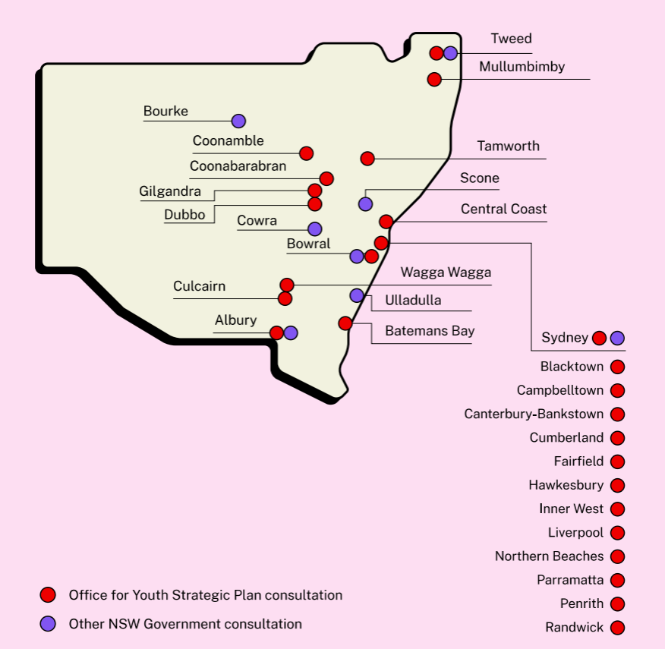
Where did we go?
EMBARGOED 17 SEPTEMBER 2026

Slide 22
Consultation with priority children and young people
The Office for Youth facilitated consultations with priority groups, including:
Aboriginal and Torres Strait Islander children and young people
Children and young people with OOHC experiences
Children and young people with disabilities and experience of mental ill-health
Young people with experiences of homelessness
Young carers and young parents
Culturally and linguistically diverse young people
Children and young people in regional and remote communities
3 x Youth justice centres
1 x AbSec forum consultation
6 x primary schools
21 x
Youth advisory groups
86 x high schools
EMBARGOED 17 SEPTEMBER 2026

Slide 23
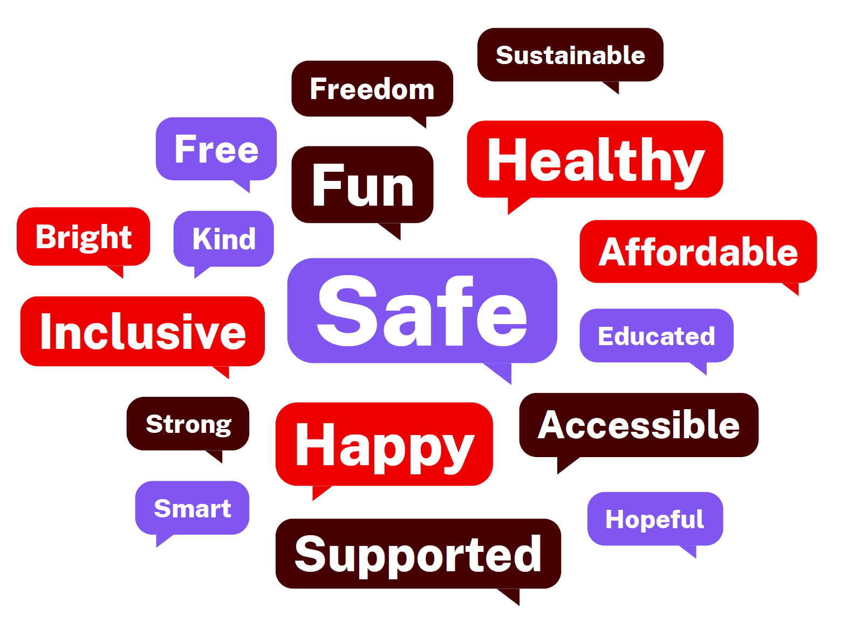
Vision for 2030
"Reduce wealth disparities, ensure equal access to education and healthcare, and promote fair representation in all areas of society."
"My aim would be to create a future where everyone has the chance to thrive, regardless of their background.”
EMBARGOED 17 SEPTEMBER 2026

Slide 24

Key findings
Healthy and well​
 | Access to affordable health care Children, young people and their families need youth-friendly, culturally responsive care and call for health hub models that treat health holistically.
 | Social determinants Stress about housing, finances, global uncertainty, and experiences of racism is a major factor impacting health and wellbeing.
 | More health information and education Young people want people want to be able to access support confidentially, More cohort specific information e.g. LGBTQIA+ health.
 | Harm minimisation for online safety and other addition harms More action is needed on online safety and responsible technology use, as well as to prevent addiction harms from vaping, alcohol, gambling and technology.
“If we don’t want our parents to know, they shouldn’t. They should be able to go without waiting for their parents’ permission.”
EMBARGOED 17 SEPTEMBER 2026

Slide 25

Key findings – Healthy and well
First Nations engagement
“Connection to culture or social opportunities as a way to improve mental health rather than just delivering a mental health service.”
 | Culture-based wellbeing Connection to culture and social opportunities is seen as a way to improve mental health and wellbeing, not just clinical services. Sport, community and school-based programs all help.
 | Cost of living, substances and racism Substance use like vaping and alcohol, COVID lockdowns, cost of living and rising racism all weigh on wellbeing.
 | Confidential, accessible services Students want confidential mental health services that don't need parental permission, plus after-hours and weekend access.
EMBARGOED 17 SEPTEMBER 2026

Slide 26

Key findings
Supported and safe​
 | Financial stress The cost of living, poverty and unmet needs are driving a range of adverse outcomes, including youth crime.
 | Safety Children and young people told us they want to feel safe at home and in the community. Young women and girls in particular raised concerns about safety.
 | Access to safe and affordable housing Housing is increasingly challenging for young people and their families, and young people experiencing homelessness need more and timely support.
 | Whole-of-government approaches There is a need for coordinated and sustainable investment in services and supports for children, young people and families.
“I feel it's way too expensive and really, really hard to live.
I'm studying full time and I'm working two jobs and I'm still
not making ends meet.”
EMBARGOED 17 SEPTEMBER 2026

Slide 27
Key findings – Supported and safe
First Nations engagement
“The best guarantee against harm in a kid’s life is the number of attuned trusted adults in their life that have got an eye on them.”
 | Trusted adults Family, teachers, Elders and informal community figures were the most consistent protective factor named.
 | Care, detention and policing Young people raised overrepresentation in out-of-home care and detention repeatedly, alongside policing and cultural stereotyping as sources of harm.
 | A service system that meets needs Basic needs – food, shelter, safety – should be met by the service system, so detention isn't filling the gap.
 | Confidentiality in small communities In small communities, young people avoid culturally embedded services out of concern that staff know their family.
EMBARGOED
17 SEPTEMBER 2026

Slide 28

Key findings
Educated and thriving​
 | Careers and lifelong learning Skills and information to navigate life after school, including careers advice and visibility, and practical life education is a top priority.
 | Financial assistance Young people need financial assistance to pursue higher education and training.
 | School engagement Support when it is needed to engage in education, including preventing disengagement, is an important preventative factor.
 | Early learning Universal access to early childhood education is key to long term outcomes.
“Many entry level positions require experience that creates a frustrating cycle of not being able to get experience.”
EMBARGOED 17 SEPTEMBER 2026

Slide 29
Key findings – Educated and Thriving
First Nations engagement
“There needs to be more funding across the state for AEOs and the school must have an Aboriginal space... they’re trying to take away the Jullum Centre, which is a crucial thing..”
 | Cultural spaces and AEOs Cultural spaces, sports programs and Aboriginal Education Officers (AEOs) are working well. Young people want First Nations histories and cultures embedded in the curriculum.
 | Practical and vocational pathways Young people want more practical life skills and vocational pathways beyond traditional HSC/ATAR routes.
 | Digital access Reliable access to digital resources like laptops is a gap for some Aboriginal students.
 | Family as first teachers Family-as-first-teachers models in early childhood build family capability alongside children's learning.
EMBARGOED
17 SEPTEMBER 2026

Slide 30

Key findings
Community connection
 | Affordable and inclusive spaces and activities Spaces to connect and belong are critical to enhancing connection and lead to positive outcomes across a range of areas.
 | Transport Public transport is a critical enabler of connection, and young people say it needs to be easier and more affordable to get where they need to go.
 | Feeling welcome and safe in public Young people, particularly young women and girls, say they do not always feel safe or welcome in public spaces or on transport, especially at night.
 | Racism and discrimination Celebrating cultures and diversity is critical to address racism and discrimination.
“No matter who you are, where you come from, what language you speak – you should still belong.”
EMBARGOED 17 SEPTEMBER 2026

Slide 31
Key findings – Community Connection
First Nations engagement
“When you dance, it feels like all the bad stuff is going away. And when you talk to Elders, it just makes you feel much better.”
 | Pride in culture and community Young people spoke with pride about their culture and want to see it reflected in public spaces through murals and language displays.
 | Culture and ACCO-led programs Cultural practices – Elders, dance, language, Ranger programs and time on Country – were the strongest source of connection, safety and belonging. Young people want grassroots, ACCO-led programs funded directly, by community for community.
 | Barriers to Country and community connection Family separation through removal and incarceration was a key concern, alongside colonial place names and disrupted cultural knowledge transmission.
EMBARGOED 17 SEPTEMBER 2026

Slide 32

Key findings
Voice and influence
 | Child and youth voice Children and young people want to have a seat at the table, whether that is through consultation, on an advisory group or through a government job.
 | Trust and accountability Government needs to be accountable for including and responding to child and youth voice, both in policies and services.
 | Being informed Young people want more education and information about voting and how government works.
 | Respect in media Children and young people deserve to be spoken about with dignity and in a way that uplifts their contributions, including in the media.
“I would want children to have a say in the decisions the government makes that can affect us.”
EMBARGOED 17 SEPTEMBER 2026

Slide 33
Key findings - Voice and influence
First Nations engagement
“Employ us if we’ve got lived and living experience of these areas.”
 | Trust and follow-through Young people are sceptical that consultation leads to change and warn it can re-traumatise them.
 | Safe, low-burden spaces Safe, low-burden spaces to be heard matter, without the burden of diagnosing systemic problems falling on those most harmed.
 | Accountability Young people want government accountability mechanisms that act and close the loop, a shift from transactional consultation to ongoing, relational engagement.
 | Being heard and believed Young people want their voices listened to and respected. Many described not being believed by teachers, parents, police and community.
EMBARGOED
17 SEPTEMBER 2026

Slide 34
Q&A

